Slide 1
HTML5
Web Application Course
Instructor: Osama Alkhoun

Slide 2
HTML5
Chapter 03

Slide 3
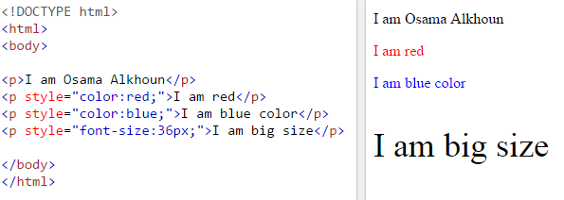
HTML Styles

Slide 4
The HTML Style Attribute
Setting the style of an HTML element, can be done with the style attribute.
The HTML style attribute has the following syntax:
<tagname style="property:value;">
The property is a CSS property. The value is a CSS value.
You will learn more about CSS later.

Slide 5
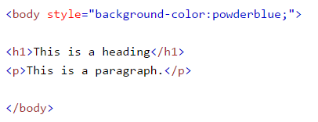
HTML Background Color
The background-color property defines the background color for an HTML element.
This example sets the background color for a page to powderblue:

Slide 6

HTML Text Color
The color property defines the text color for an HTML element:

Slide 7

HTML Fonts
The font-family property defines the font to be used for an HTML element:

Slide 8

HTML Text Size
The font-size property defines the text size for an HTML element:

Slide 9

HTML Text Alignment
The text-align property defines the horizontal text alignment for an HTML element:

Slide 10
Chapter Summary
Use the style attribute for styling HTML elements
Use background-color for background color
Use color for text colors
Use font-family for text fonts
Use font-size for text sizes
Use text-align for text alignment

